Slide 1
Class

Slide 2
A class is a data structure that can store data and execute code.
It contains the following:
• Data members, which store data associated with the class or an instance of the class. Data members generally model the attributes of the real-world object the class represents.
• Function members, which execute code. Function members generally model the functions and actions of the real-world object the class represents.

Slide 3
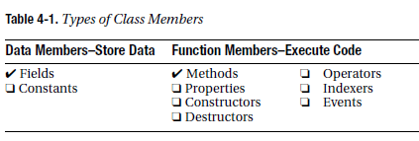
A C# class can have any number of data and function members. The members can be any combination of nine possible member types. These member types are listed in table.

Slide 4
Declaring a Class
A class declaration defines the characteristics and members of a new class. It does not create an instance of the class, but creates the template from which class instances will be created.
The class declaration provides the following:
• The class name
• The members of the class
• The characteristics of the class
The following is an example of the minimum syntax for a class declaration. The curly
braces contain the member declarations that make up the class body. Class members can be declared in any order inside the class body. This means that it is perfectly fine for the declaration of a member to refer to another member that is not yet defined until further down in the class declaration.
class MyExcellentClass
{
MemberDeclarations
}

Slide 5
For example, the following code shows the outlines of two class declarations:
class Dealer // Class declaration
{
...
}
class Player // Class declaration
{
...
}

Slide 6
Class Members
Fields and methods are the most important of the class member types. Fields are data members and methods are function members.
Fields
A field is a variable that belongs to a class.
• It can be of any type, either predefined or user-defined.
• Like all variables, fields store data, and have the following characteristics:
– They can be written to.
– They can be read from.
The minimum syntax for declaring a field is the following:
Type
↓
Type Identifier;
↑
Field name
For example, the following class contains the declaration of field MyField, which can store an int value:
class MyClass
{ Type
↓
int MyField;
↑
} Field name

Slide 7
Explicit and Implicit Field Initialization
Since a field is a kind of variable, the syntax for a field initializer is the same as that of the variable initializer
• A field initializer is part of the field declaration, and consists of an equals sign followed
by an expression that evaluates to a value.
• The initialization value must be determinable at compile time.
class MyClass
{
int F1 = 17;
} ↑
Field initializer
• If no initializer is used, the value of a field is set by the compiler to a default value, determined by the type of the field, the default value for each type is 0, and false for bool. The default for reference types is null.
class MyClass
{
int F1; // Initialized to 0 - value type
string F2; // Initialized to null - reference type
int F3 = 25; // Initialized to 25
string F4 = "abcd"; // Initialized to "abcd"
}

Slide 8
Methods
A method is a named block of executable code that can be executed from many different parts of the program, When a method is called, or invoked, it executes its code, and then returns to the code that called it. Some methods return a value to the position from which they were called. Methods correspond to member functions in C++.
The minimum syntax for declaring a method includes the following components:
• Return type: This states the type of value the method returns. If a method does not return a value, the return type is specified as void.
• Name: This is the name of the method.
• Parameter list: This consists of at least an empty set of matching parentheses. If there are parameters (which I’ll talk about parameters later), they are listed between the parentheses.
• Method body: This consists of a matching set of curly braces, containing the executable code.
For example, the following code declares a class with a simple method called PrintNums.
From the declaration, you can tell the following about PrintNums:

Slide 9
• It returns no value; hence, the return type is specified as void.
• It has an empty parameter list.
• It contains two lines of code in its method body.
class SimpleClass
{
Return type Parameter list
↓ ↓
void PrintNums ( )
{
Console.WriteLine("1");
Console.WriteLine("2");
}
}

Slide 10
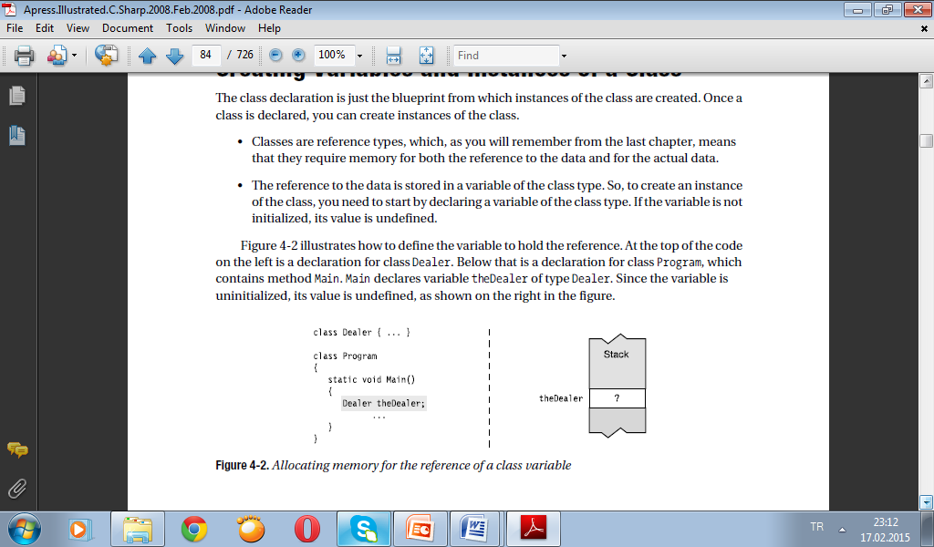
Creating Variables and Instances of a Class
The class declaration is just the blueprint from which instances of the class are created. Once a class is declared, you can create instances of the class.
• Classes are reference types, which, as you will remember from the last chapter, means that they require memory for both the reference to the data and for the actual data.
• The reference to the data is stored in a variable of the class type. So, to create an instance of the class, you need to start by declaring a variable of the class type. If the variable is not initialized, its value is undefined.

Slide 11
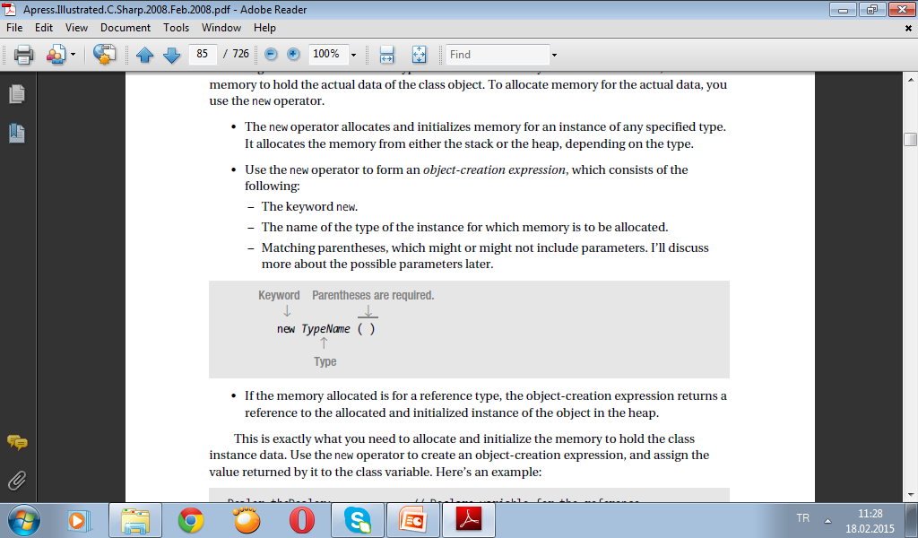
Allocating Memory for the Data
Declaring the variable of the class type allocates the memory to hold the reference, but not the memory to hold the actual data of the class object. To allocate memory for the actual data, you use the new operator.
• The new operator allocates and initializes memory for an instance of any specified type. It allocates the memory from either the stack or the heap, depending on the type.
• Use the new operator to form an object-creation expression, which consists of the
following:
– The keyword new.
– The name of the type of the instance for which memory is to be allocated.
– Matching parentheses, which might or might not include parameters. I’ll discuss
more about the possible parameters later.

Slide 12
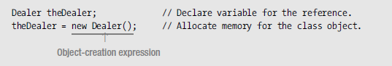
If the memory allocated is for a reference type, the object-creation expression returns a reference to the allocated and initialized instance of the object in the heap.
This is exactly what you need to allocate and initialize the memory to hold the class instance data. Use the new operator to create an object-creation expression, and assign the value returned by it to the class variable. Here’s an example:

Slide 13
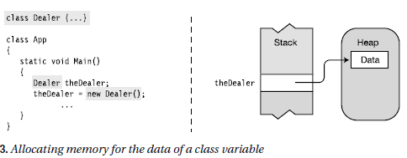
The code on the left in Figure shows the new operator used to allocate memory and create an instance of class Dealer, which is then assigned to the class variable. The memory structure is illustrated in the figure, to the right of the code.

Slide 14
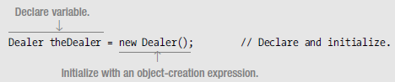
Combining the Steps
The two steps can be combined by initializing the variable with the object-creation expression.
In the case of local variables, but not fields, you can simplify the syntax a bit more by having the compiler infer the type in the declaration part on the left.

Slide 15
Instance Members
A class declaration acts as a blueprint from which you can create as many instances of the class as you like.
• Instance members: Each instance of a class is a separate entity that has its own set of the data members, distinct from the other instances of the same class. These are called instance members since they are associated with an instance of the class.
• Static members: Instance members are the default, but you can also declare members that are associated with the class, rather than the instance. These are called static members, and they will be covered in Chapter 6.
As an example of instance members, the following code shows the a sample game program with three instances of class Player. Figure shows that each instance has a different value for the Name field.

Slide 16
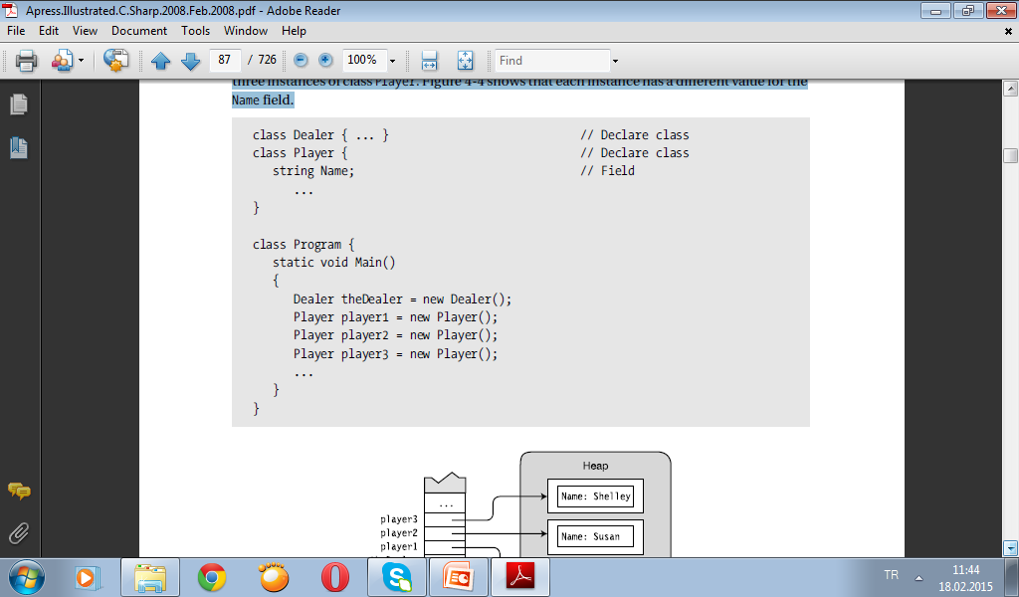
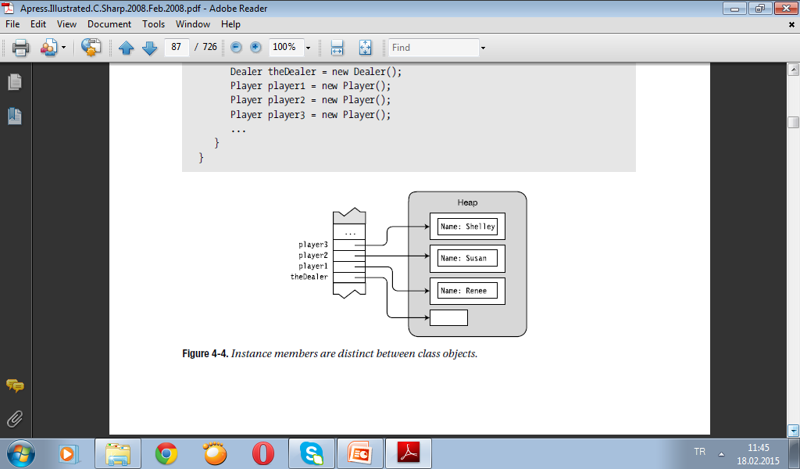

Slide 17
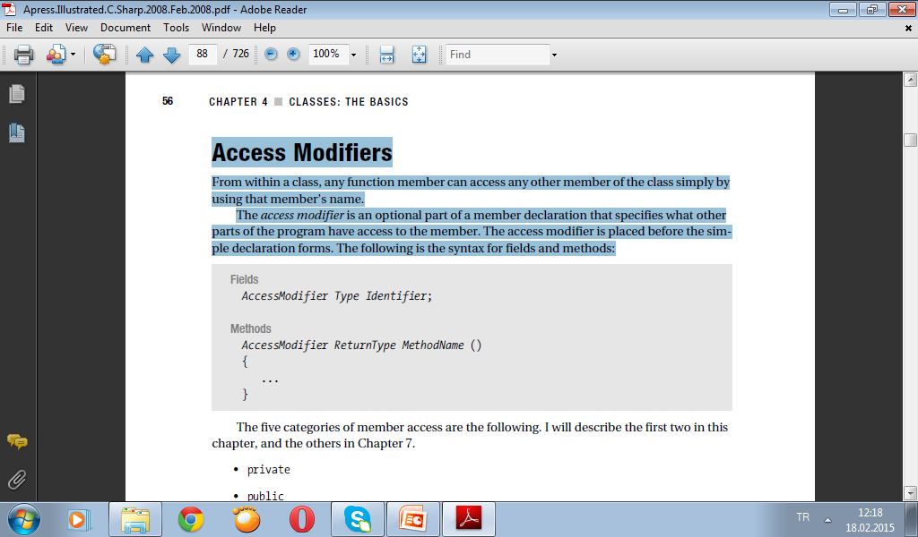
Access Modifiers
From within a class, any function member can access any other member of the class simply by using that member’s name.
The access modifier is an optional part of a member declaration that specifies what other parts of the program have access to the member. The access modifier is placed before the simple declaration forms. The following is the syntax for fields and methods:

Slide 18
The five categories of member access are the following. I will describe the first two in here, and the others will describe later.
• private
• public
• protected
• internal
• protected internal
Private and Public Access
Private members are only accessible from within the class in which they are declared—other classes cannot see or access them.
• Private access is the default access level—so if a member is declared without an access modifier, it is a private member.
• You can also use the private access modifier to explicitly declare a member private.
• There is no semantic difference between declaring a private member implicitly as opposed to explicitly. The forms are equivalent.
For example, the following two declarations both specify private int members:
int MyInt1; // Implicitly declared private
private int MyInt2; // Explicitly declared private

Slide 19
Public members are accessible to all other objects in the program. You must use the public access modifier to specify public access.
Access modifier
↓
public int MyInt;

Slide 20
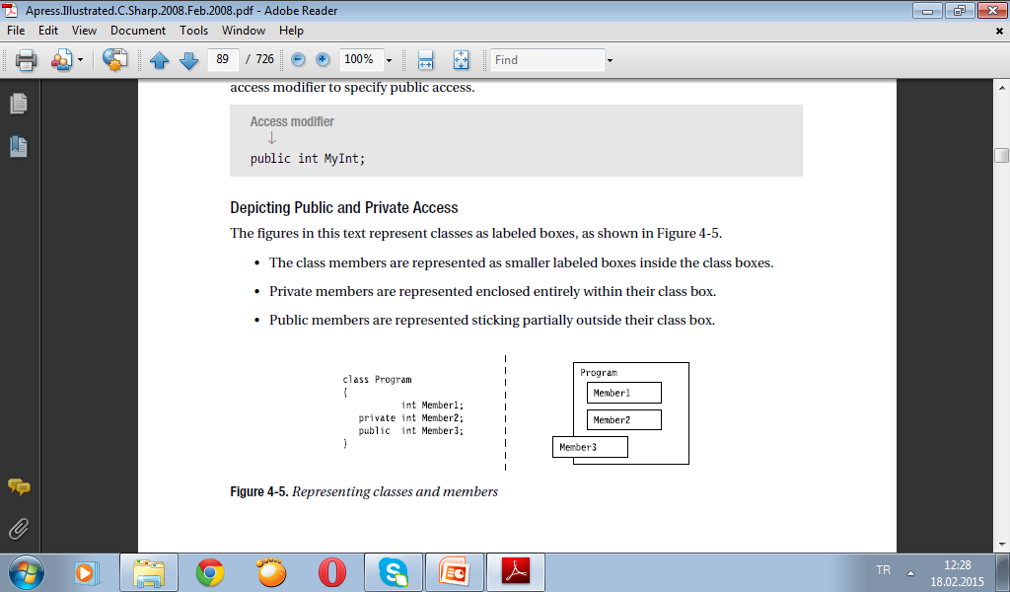
Depicting Public and Private Access
The figures in this text represent classes as labeled boxes, as shown in following Figure.
• The class members are represented as smaller labeled boxes inside the class boxes.
• Private members are represented enclosed entirely within their class box.
• Public members are represented sticking partially outside their class box.

Slide 21
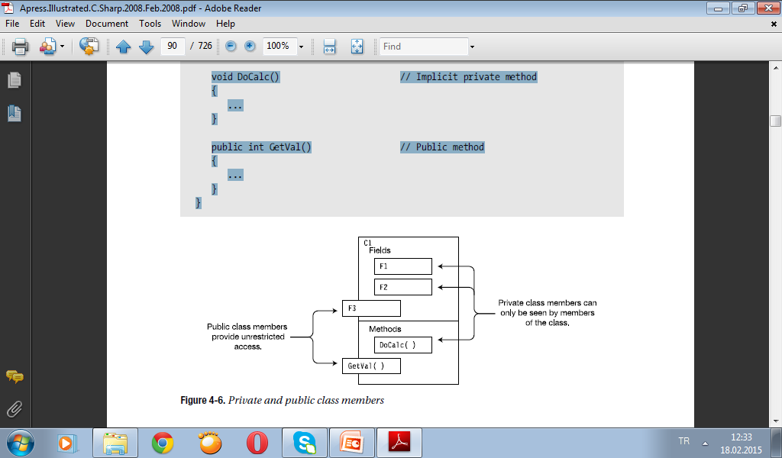
Example of Member Access
Class C1 declares both public and private fields and methods. Figure illustrates the visibility of the members of class C1.
class C1
{
int F1; // Implicit private field
private int F2; // Explicit private field
public int F3; // Public field
void DoCalc() // Implicit private method
{
...
}
public int GetVal() // Public method
{
...
}
}

Slide 22
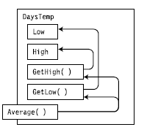
Accessing Members from Inside the Class
As mentioned before, members of a class can access the other class members by just using their names.
For example, the class declaration shows the methods of the class accessing the fields and other methods. Even though the fields and two of the methods are declared private, all the members of a class can be accessed by any method (or any function member) of the class.
class DaysTemp
{
// Fields
private int High = 75;
private int Low = 45;
// Methods
private int GetHigh()
{
return High; // Access private field
}
private int GetLow()
{
return Low; // Access private field
}
public float Average ()
{
return (GetHigh() + GetLow()) / 2; // Access private methods
} ↑ ↑
} Accessing the private methods

Slide 23
Accessing Members from Outside the Class
To access a public instance member from outside the class, you must include the variable name and the member name, separated by a period (dot). This is called dot-syntax notation
For example, the second line of the following code shows an example of accessing a method from outside the class:
DaysTemp myDt = new DaysTemp(); // Create an object of the class.
float fValue = myDt.Average(); // Access it from outside.
↑ ↑
Variable name Member name

Slide 24
As an example, the following code declares two classes: DaysTemp and Program.
• The two fields in DaysTemp are declared public, so they can be accessed from outside the class.
• Method Main is a member of class Program. It creates a variable and object of class DaysTemp, and assigns values to the fields of the object. It then reads the values of the fields and prints them out.
class DaysTemp // Declare class DaysTemp
{
public int High = 75;
public int Low = 45;
}
class Program // Declare class Program.
{
static void Main()
{ Variable name
↓
DaysTemp temp = new DaysTemp(); // Create the object.
Variable name and field
↓
temp.High = 85; // Assign to the fields.
temp.Low = 60; Variable name and field
↓
Console.WriteLine("High: {0}", temp.High ); // Read from fields.
Console.WriteLine("Low: {0}", temp.Low );
}
}
High: 85
Low: 60

Slide 25
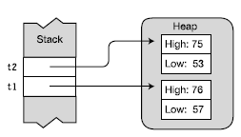
class DaysTemp // Declare the class.
{
public int High, Low; // Declare the instance fields.
public int Average() // Declare the instance method.
{
return (High + Low) / 2;
}
}
class Program
{
static void Main()
{
// Create two instances of DaysTemp.
DaysTemp t1 = new DaysTemp();
DaysTemp t2 = new DaysTemp();
// Write to the fields of each instance.
t1.High = 76; t1.Low = 57;
t2.High = 75; t2.Low = 53;
// Read from the fields of each instance and call a method of
// each instance.
Console.WriteLine("t1: {0}, {1}, {2}",
t1.High, t1.Low, t1.Average() );
Console.WriteLine("t2: {0}, {1}, {2}",
t2.High, t2.Low, t2.Average() );
↑ ↑ ↑
} Field Field Method
}
Putting It All Together
The code creates two instances and stores their references in variables named t1 and t2. The code demonstrates the following three actions discussed so far in the use of a class:
• Declaring a class
• Creating instances of the class
• Accessing the class members (i.e., writing to a field and reading from a field)
t1: 76, 57, 66
t2: 75, 53, 64

